Slide 1
Insightful Interfaces
Saiteja Bevara, Rithik Yelisetty and William Zhang
October 11, 2020

Slide 2
Motivation
People have made various claims regarding how different demographics have affected the trends regarding the spread of COVID-19
Prominent predictions that are noted in common media outlets have been based primarily on previous case counts
We want our predictions for the spread of COVID-19 to include demographic data and income in order to better predict the next hotspots in the state of Virginia
Notes:
The motivation of this project

Slide 3
Background
COVID-19 has brought the world to a halt
Infected over 37,000,000 individuals
Killed over 1,000,000 people
Closed borders for travel
Shut down economies
Datasets
https://data.virginia.gov/Government/VDH-COVID-19-PublicUseDataset-Cases/bre9-aqqr/data
Cases, hospitalizations, and deaths (per locality)
https://data.ers.usda.gov/reports.aspx?ID=17828
Socioeconomic data: Unemployment rate and median household income (per locality)
https://www.cdc.gov/nchs/nvss/bridged_race.htm#Newest%20Data%20Release
Demographic data including distributions of age and race
Notes:
The motivation of this project

Slide 4
Related Work
Many related projects have been completed on trying to associate COVID-19 case counts and demographic data
https://www.kaggle.com/nightranger77/covid19-country-eda
Using metrics like 2018 GDP, Crime and Population, Smoking rate, Percent Female, Median Age and COVID-19 specific data, project found that countries with higher GDP, age population and smoking levels had more infections
https://www.ncbi.nlm.nih.gov/pmc/articles/PMC7258807
Considered environmental and economic factors as distribution indicators of COVID-19 using bivariate correlation and regression tests
Concluded that higher GDP was correlated with more COVID-19 and temperature had a reverse association
https://www.kaggle.com/willshamma/covid-19-demographic-susceptibility
This notebook looked at how population age directly influenced the cases, hospitalizations, ICU admissions and deaths for COVID-19
The study found that the people admitted to the ICU across all age groups was roughly equal
Notes:
Here, we make the claim of this project.

Slide 5
Claim / Target Task
Predict future cases of COVID-19 based on past confirmed case count as well as the population and demographics of the area in Virginia.
The factors / model features that will be considered will be case count, along with demographic data such as race distribution, age group distribution, median income and unemployment rate
The output or label assigned will be predicted number of new cases expected for the next day
Notes:
Here, we make the claim of this project.

Slide 6
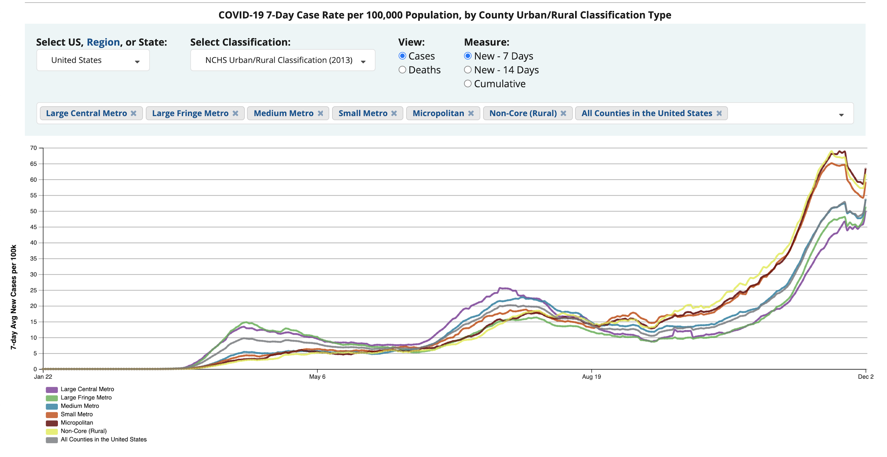
An Intuitive Figure Showing WHY needed
Notes:
Here, we make the claim of this project.

Slide 7
Proposed Solution
Combine demographic data sets for race, age group, unemployment rate, median household income by VA locality
Match the demographic data by FIPS code to VA COVID-19 cases
Implement an MLP model to predict the number of COVID-19 cases the next day
Train the MLP model on the combined and matched dataset
Tune hyperparameters to find the best model architecture and parameters for training
Notes:
Here is our proposed solution.

Slide 8
Implementation
All data from training set is shuffled and 90% is used for training and 10% is used for testing
From the 90% of data used for the training, a validation split of 0.1 is used to pick best model
MLP-based Sequential Model created using Keras
20 hidden layers between input and output layer with a hidden dimension of 200 nodes and “relu” activation function
Dropout layer between hidden layers and output to remove all extraneous data
Output layer returns 1 number (case count) with the “linear” activation function
Adam optimizer and Mean Squared Logarithmic Error Loss Function is used for the model
Via hyperparameter training, the model uses a learning rate of 0.0000005 and is run for 20 epochs
Notes:
In the rest of this presentation, I’m going to talk about following contents:

Slide 9
Contributions
By combining VA demographic data and COVID-19 case count data, we:
Provided a better picture of the correlation between demographic factors and case counts
Provided a better indication of which demographic categories impacted case counts in VA
Provided predictions for case counts at a county level based on demographic factors and past case counts
Notes:
In the rest of this presentation, I’m going to talk about following contents:

Slide 10
Data Summary
Three distinct datasets were used to gather information about demographics (age, race, unemployment percent and median household income) and COVID-19 case counts
For the age and race data, each group is measured as a percent of the total population. Once percentages are computed, all data is added to a SQL table.
For the unemployment percent and median household, US census data is used to insert all relevant data into a separate SQL table.
COVID-19 case counts for the past 10 days are also added to a SQL Table for each FIPS district along with the current day.
All data is combined on FIPS district using the SQL NATURAL JOIN command. This data is then read by the pandas library and outputted to a csv format to be ingested by the ML model.
Notes:
In the rest of this presentation, I’m going to talk about following contents:

Slide 11
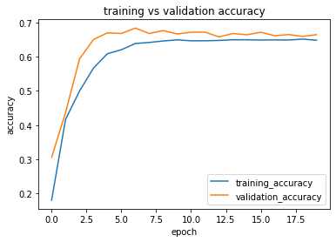
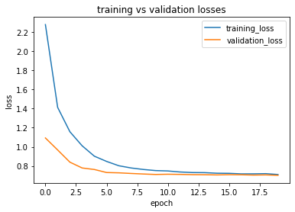
Experimental Results
Best Performing MLP Model
Batch_size: 8, epoch: 20, learning_rate: 0.0000005, hidden_dim: 200, hidden_layer: 20, optimizer: adam
Validation Accuracy: ~67%
Test Accuracy: ~66%
Notes:
In the rest of this presentation, I’m going to talk about following contents:

Slide 12
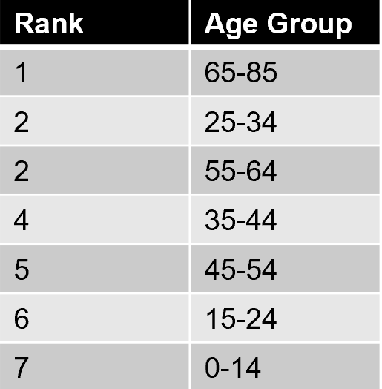
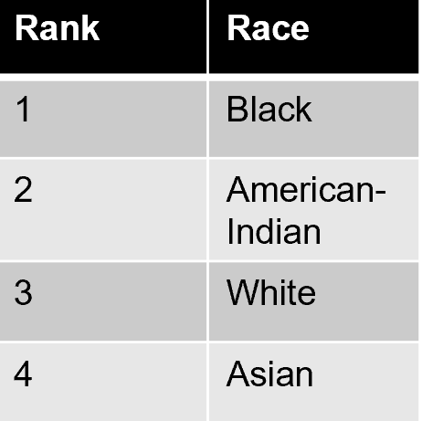
Experimental Analysis
With the given dataset, the best accuracy for all models and parameters was around ~0.65
More data for each county or other demographic factors could increase accuracy
Certain input features were more indicative of a higher number of predicted cases
Lower unemployment rate and lower median household income
Notes:
In the rest of this presentation, I’m going to talk about following contents:

Slide 13
Conclusion and Future Work
Model performance was relatively good
Largest range of daily new COVID-19 case counts in Fairfax County
Range from 0 to ~500
Baseline accuracy of < ~0.2% (random guessing)
65% accuracy relatively high in comparison
Determined that of the demographic factors taken into account, age group and race in a locality had the most impact on the next day’s case count
Further work could consider a larger number of demographic factors and take more factors into account (i.e. smoking, population density)

Slide 14
References
https://data.virginia.gov/Government/VDH-COVID-19-PublicUseDataset-Cases/bre9-aqqr/data
https://data.ers.usda.gov/reports.aspx?ID=17828
https://www.cdc.gov/nchs/nvss/bridged_race.htm#Newest%20Data%20Release
https://www.kaggle.com/nightranger77/covid19-country-eda
https://www.ncbi.nlm.nih.gov/pmc/articles/PMC7258807
https://www.kaggle.com/willshamma/covid-19-demographic-susceptibility
https://keras.io/api/
https://covid.cdc.gov/covid-data-tracker/#pop-factors_7daynewcases

